Slide 1
E Banking Application Automation using Selenium Http: https://demo.guru99.com/v3/index.php

Slide 2
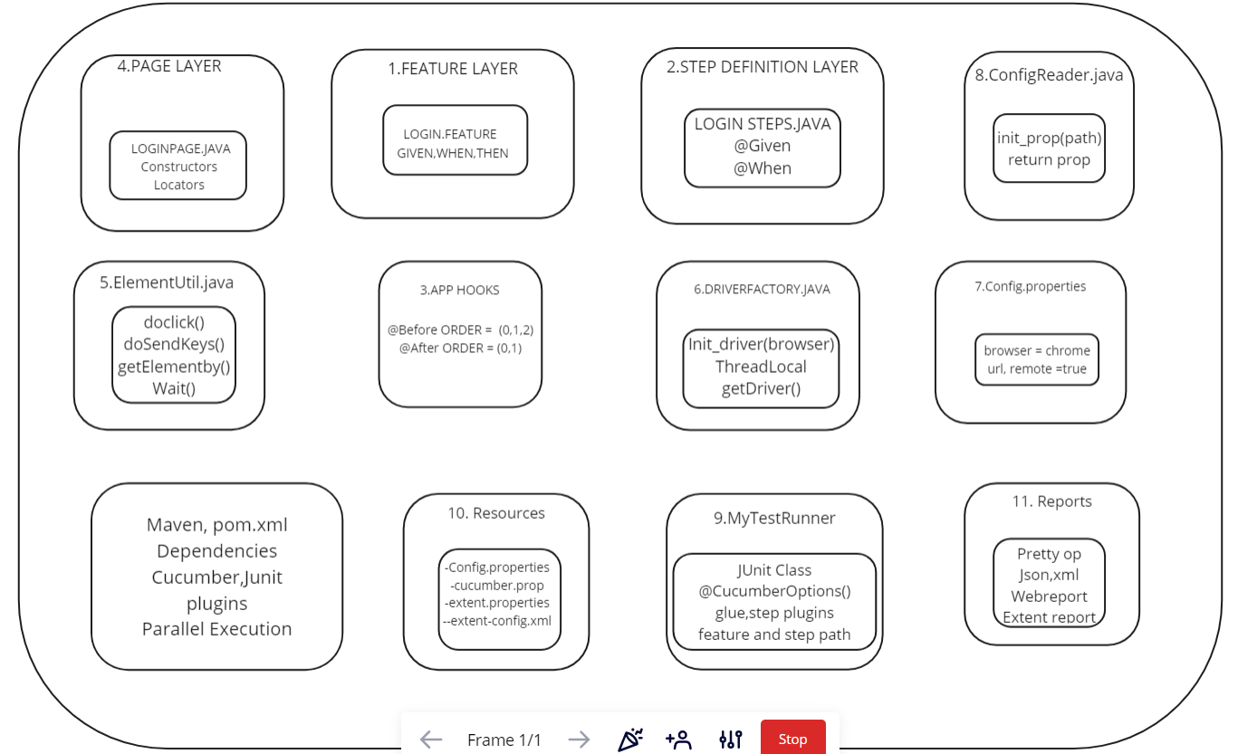

Slide 3
Automation Framework
Page Objects(1)
Loginpage.java
AddCustomer.java
EditCustomer.java
DeleteCustomer.java
Maven Run.bat(6)
TestNG.xml(5.1)
Test Cases(4)
Utilities(2)
ReadConfig.java
Reporting.java
XLUtils.java
Base Class
Test Data
Jenkins(7)
Pom.xml
(5.2)
1.LoginText.java
2.AddNewCustomer.java
3. Edit Customer.java
4.Delete Customer.java
Config Files(3)
Pom.xml
Extent-config.xml
Config.properties
Report

Slide 4
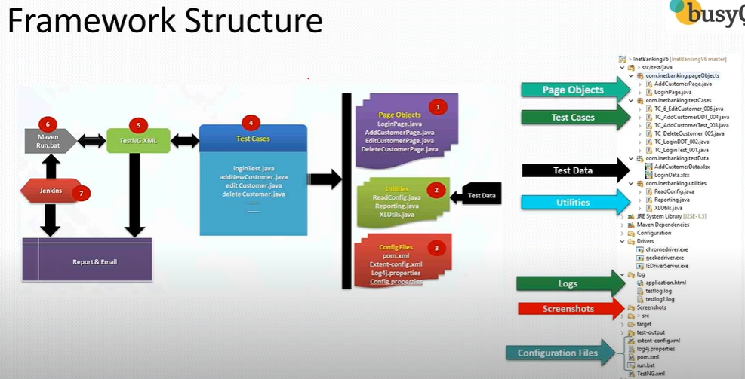

Slide 5
Stages of Framework:-
Implementation/Development of Framework ( Test Data, Page Objects, Utilities, Config files and Test Cases)
Execution Part (TestNG.xml and pom.xml)
Continuous Integration Part (Maven run.bat and Jenkins)

Slide 6
Implementation Phase
Create Maven Project
Update pom.xml
Create Page Objects
Create Basic Test Case
Read Common values from properties file
Run test case on desired browser
Add extent report
Create data driven test case
Adding new test case (create the page object class and automate it)

Slide 7
Execution Phase
Run test cases with Maven pom.xml
Run test cases through Maven CLI
Run test cases through command line using run.bat
Run test cases through Jenkins via bat file.

Slide 8
Maintenance Phase
Create Repository in Git Hub
Commit the project code in local repository
Push the project code to Git Hub remote repository from local GIT repository

Slide 9
Step by Step Implementation:-
Create a Maven Project
Pom.xml file comes by default
Adding dependencies in pom.xml
Dependencies automatically download the Jars (web-driver, TestNG, XL, Extend report jars etc)
Dependencies:-

Slide 10
PageObjects Packages:
Create LoginPage class under PageObject package.
Username, Password and Login Button passed.

Slide 11
Test Case
Setup Method: Pre requisites(system.setproperty, creation of timer object which are executed before class)
Test Method: All steps (
Teardown Method: After Class (closure related commands being passed)
Setup and Teardown methods are required for every test case.
Base Class created where these 2 are kept as common.
Base class inherited/extend to each test case.

Slide 12
Utilities
Reading common values from properties file.
Config.properties:- All the common variables along with value are placed here. It is part of Configuration folder.
ReadConfig.java:- Reads values of config.properties file. It acts as a mediator where it reads the values and the base class will take those values. It is part of utilities package.
./ in path:- in java classes as well as in properties file to get the project home driectory.
System.getProperty("user.dir"):- Used only in Java classes.

Slide 13
Add extent Reports
Jars
Extent-config.xml
Listener (Reporting.java) -> Utility file

